Slide 1
Bookmarked
Team Darkside
Notes:
ALL

Slide 2
Agenda
Scope of the system
Functional requirements
Nonfunctional requirements
Use categories in Nonfunctional-requirement.
Development technology (i.e DB, Test Framework, Development Framework etc.)
System Architectural Design (CBA, Client/Server etc.)
Burnup Chart
Burndown Chart (including total points planned and accepted for each sprint)
Velocity Chart
Obstacle Board (status (open/closed/resolved,....), actions taken, owner, etc.)
Notes:
Justin

Slide 3
System Scope
Our goal with Bookmarked is to create a more seamless and less convoluted process for viewing media content. This includes:
Sharing multiple media types: images, GIFs, and videos
Viewing other’s content directly from thumbnails or in detail views
Searching through your own and others’ content
Creating a personal profile where you can manage your content.
Create collections of content that can also be shared
Favorite content and make it more visible on your profile page
Notes:
Jesus

Slide 4
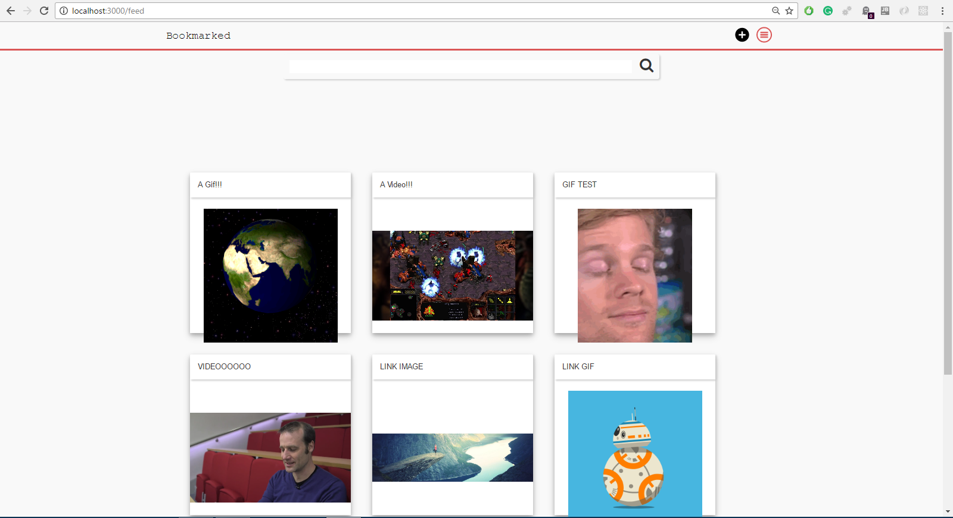
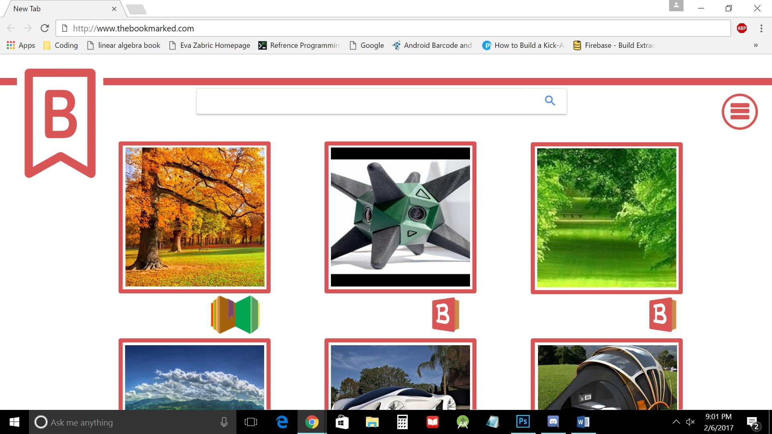
Where we are. Where we’re headed.
Notes:
Paul

Slide 5
Functional Requirements
Services:
Main feed
Search by:
Video name
GIF name
Image name
Theme/Collections
Register user
Log in user
User Profiles:
Username
Add/edit/delete
Bio
Picture
Bookmarks
Super Bookmarks
Collections
Bookmarks:
Video upload
Youtube link
GIF upload
Image upload
Bookmark collections
Notes:
Marie/Prem/Ian

Slide 6
Nonfunctional Requirements
Usability
1-2 clicks to access features
Reliability
10+ users browsing at the same time
Performance
<1 second load times
Supportability
Provide requested technical assistance to the user within 48 hours
Implementation
ReactJS, JavaScript, HTML, CSS
Firebase
Interface
Aesthetics
Homepage Redirection, Login/Register Sign in, Search, Upload Bookmarks, User Profiles
Legal
MIT license for project
EULA for users
Notes:
Justin

Slide 7


Nonfunctional Requirements - Packaging
Domain name registered with Namecheap.
Hosted on AWS EC2 server instance
Publically available!
http://bookmarked.fun
Notes:
Yoho

Slide 8






Development Technologies
Notes:
Prem

Slide 9
System Architectural Design
Client/Server:
Web application, so uses the base client/server software architecture, with browsers (clients) requesting and sending data to/from Firebase, the application server and database.
React.js Component-Based Architecture:
As opposed to MVC, CBA splits responsibilities vertically, allowing each component to take care of both its own display and logic, rather than separating logic and display into separate layers.
Components are easily reusable.
DOM can be dynamically updated without the need of a page refresh.
Notes:
Jack

Slide 10
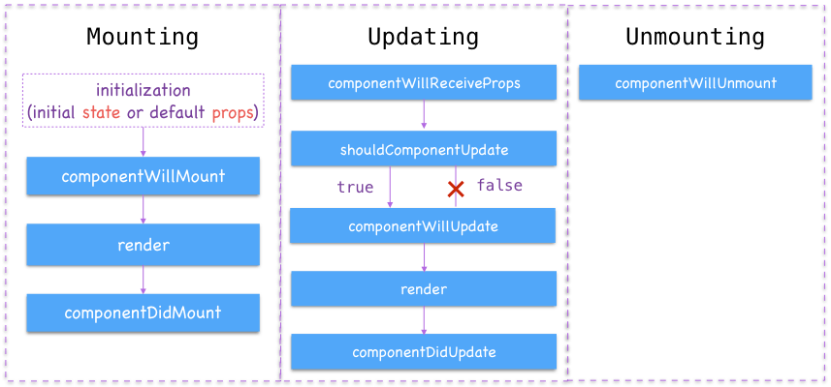
Components Continued (Theory)
Notes:
Jack

Slide 11
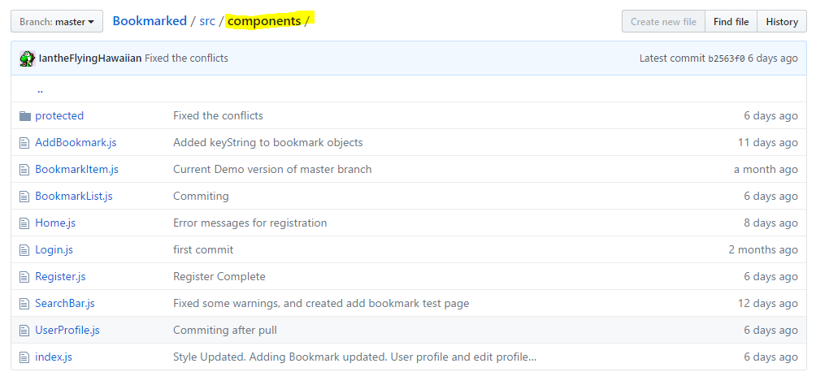
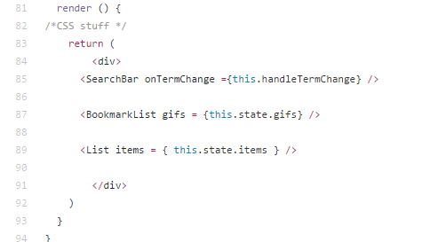
Components Continued (Example)
Notes:
Jack

Slide 12
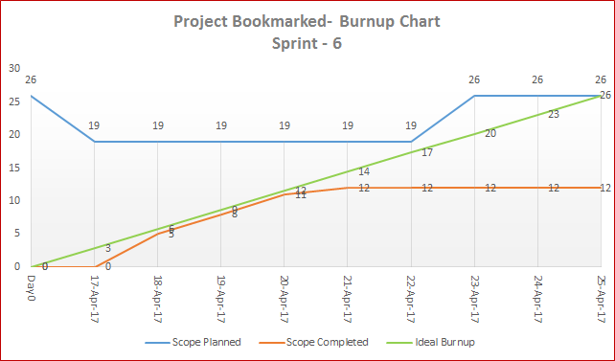
Burnup Chart - Sprint 6
Notes:
Ian

Slide 13
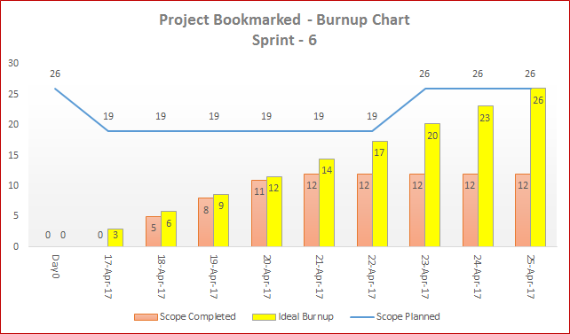
Burnup Chart Continued
Notes:
Ian

Slide 14
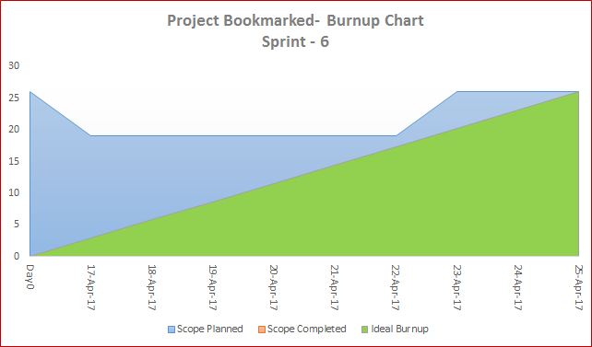
Burnup Chart Continued
Notes:
Ian

Slide 15
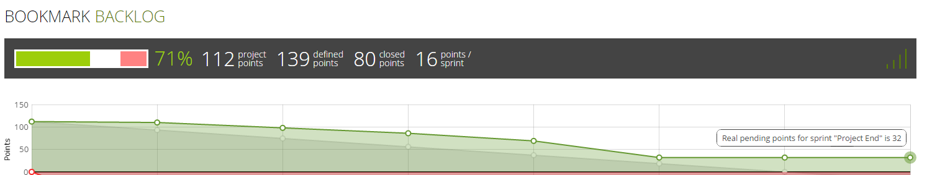
Burndown Chart
Each dot represents end of Sprint dates:
Feb 20th - 2 points completed (Setting up Environment)
Feb 27th - 12 points completed (Forming)
Mar 13th - 12 points completed (Storming)
Mar 20th - 17 points completed (Norming)
April 10th - 37 points completed (Performing)
April 24th - TBD
May 6th - TBD
Notes:
Ian

Slide 16
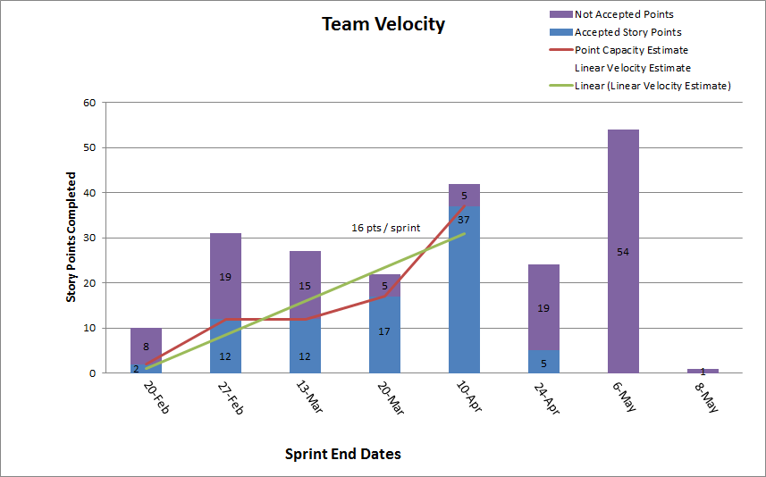
Velocity Chart
Notes:
Ian

Slide 17
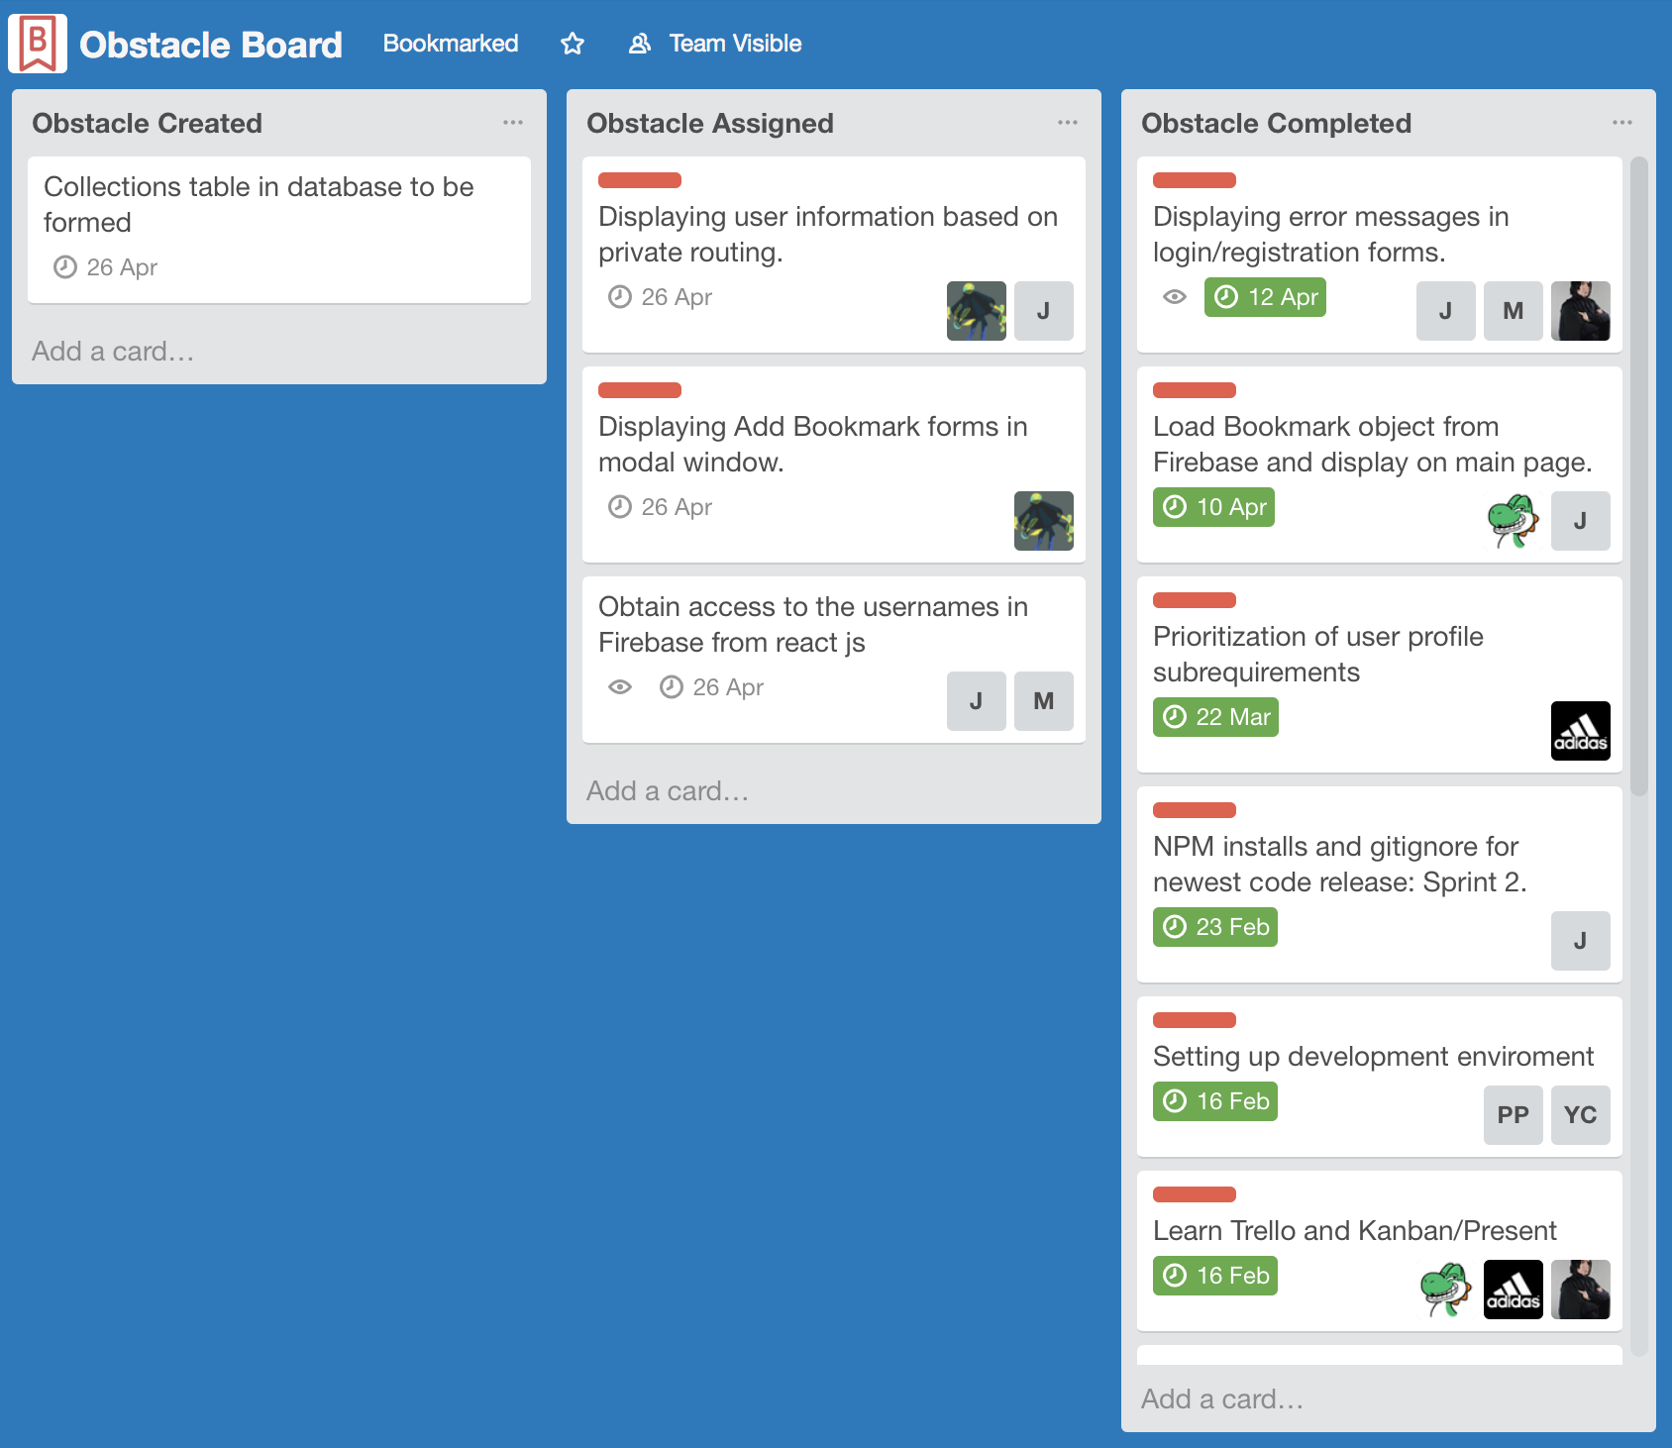
Obstacle Board
Obstacles include three sections:
Created
Assigned
Completed
All assigned obstacles have:
Due date
Owner
Completed marker (Green timestamp)
Notes:
Jack

Slide 18
Any Questions?
Thank you
Notes:
Marie

